Slide 1

Azure Synapse Analytics
Limitless analytics service with unmatched time to insight
Artificial Intelligence / Machine Learning / Internet of Things
Intelligent Apps / Business Intelligence
Designed for analytics workloads at any scale
Synapse Analytics
SaaS developer experiences for code free and code first
Experience
Synapse Analytics Studio
Platform
Multiple languages suited to different analytics workloads
MANAGEMENT
Languages
MANAGEMENT
SQL
Python
.NET
Java
Scala
R
Integrated analytics runtimes available provisioned and serverless on-demand
SQL Analytics offering T-SQL for batch, streaming and interactive processing
Spark for big data processing with Python, Scala, R and .NET
SECURITY
Form Factors
SECURITY
PROVISIONED
ON-DEMAND
MONITORING
Analytics Runtimes
MONITORING
SQL
METASTORE
METASTORE
DATA INTEGRATION
Integrated platform services for, management, security, monitoring, and metastore
Azure
Data Lake Storage
Common Data Model
Enterprise Security
Optimized for Analytics
Data lake integrated and Common Data Model aware

Slide 2













Slide 3

Create the model
Register the model
Use the model
Apache Spark Pool
SQL Pool
SQL Pool
Notebook
SQL Script
SQL Script
Train Model
Read model
Load model from Table
Convert to ONNX
Load into Table
Use Predict
Export to Storage
Insert Predictions
Storage
Models
Hex encode model file (External PowerShell Script)

Slide 4















Modern Data Warehouse
INGEST
PREPARE
TRANSFORM
SERVE
VISUALIZE
Oracle
Sales Transactions
AZURE SYNAPSE ANALYTICS
SAP Hana
Finance Data
Power BI
Dashboards & Reports
Pipeline
Ingest
SQL Pools
Spark Pools
Pipeline
Transform, Score & Load
SQL Pools
Query & Predict
OR
Teradata
Marketing Data
SQL On-Demand
Ad-Hoc Query
SQL Pools / SQL On-Demand
Databases (SQL Pool)
Data Warehouse
WebJob
Twitter Feed Consumer
Stream Analytics
Data Lake
Azure ML
Model Training & Registry
Twitter
Tweets
IoT Sensors
In-store Traffic Data
IoT Hub
Streaming Data
Event Hubs
Streaming Data
ADLS Gen 2
Storage Account
Data Lake (Avro & Parquet)
Explore & Prep

Slide 5




Slide 6






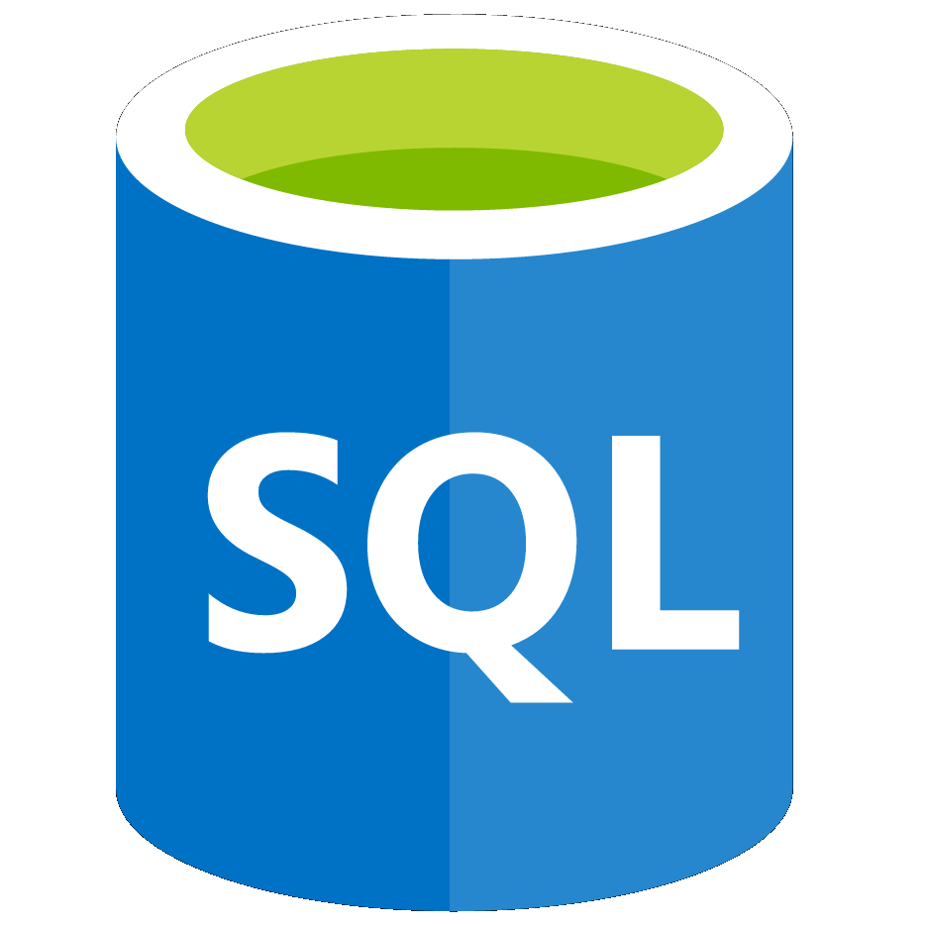



Exercise 4 (15 mins)
Lake Databases and
Database Templates
Exercise 5 (15 mins)
Log and Telemetry Analytics
Exercise 3 (10 mins)
High Performance Analysis
with Azure Synapse
Dedicated SQL Pools
Exercise 6 (15 mins)
Data Governance with
Azure Purview
Unified Experience
Azure Synapse Studio
On-prem
Integration
Database Templates
Management
Monitoring
Security
DevOps
Cloud data
Analytic runtimes
SQL
Data Explorer
Applications
Semantic Layer – Common Data Model
Streaming data
Data Warehouse
Data Lake
Event Brokers
Azure Synapse Link
Exercise 2 (35 mins)
Working with
Azure Synapse Pipelines
Cosmos DB
Dataverse
Exercise 7 (15 mins)
Power BI Integration
Exercise 1 (15 mins)
Explore the data lake with Azure Synapse Serverless SQL Pool and Azure Synapse Spark
Exercise 8 - Optional (20 mins)
Data Science with
Azure Synapse Spark and
Azure Machine Learning
Notes:
Azure Synapse unifies your data, your data tasks, and your data teams with a limitless analytics service that does it all. This is the result of a multi-year effort.
We set out to rearchitect and create the next generation of query processing and data management with Synapse to meet the needs of the modern, high scale, volume, velocity, and variety of data workloads.
As these modern workloads require both SQL and Apache Spark, we saw that customers would need a cloud-native analytics service engine that converged big data and data warehousing so they could achieve limitless scale on structured, semi-structured, and un-structured data.
Kim

